Slide 1
Secure Data Hiding in Image Using Steganography
CAPSTONE PROJECT
Presented By
Student Name : Ankit Kumar
Chouksey Engineering College & Computer Science

Slide 2
OUTLINE
Problem Statement
Technology used
Wow factor
End users
Result
Conclusion
Git-hub Link
Future scope

Slide 3
Problem Statement
The increasing need for secure communication in the digital age.
Traditional data transmission methods are prone to unauthorized access and interception.
Steganography allows hiding data within images, making it invisible to the human eye.
This project focuses on securely embedding encrypted data into images, ensuring confidentiality.
Conventional methods of data transmission are vulnerable to hacking and unauthorized access.

Slide 4
Technology used
Python: The main programming language used for the development of this project.
PyArmor: A library used for protecting the Python script, which prevents it from being easily reverse-engineered, thereby adding an extra layer of security.
Pillow: A Python Imaging Library (PIL) fork used for handling image processing tasks, such as embedding and extracting hidden data from images.
Cryptography: A library for encrypting the data before hiding it in the image, ensuring that only authorized users can retrieve and decode the hidden data

Slide 5
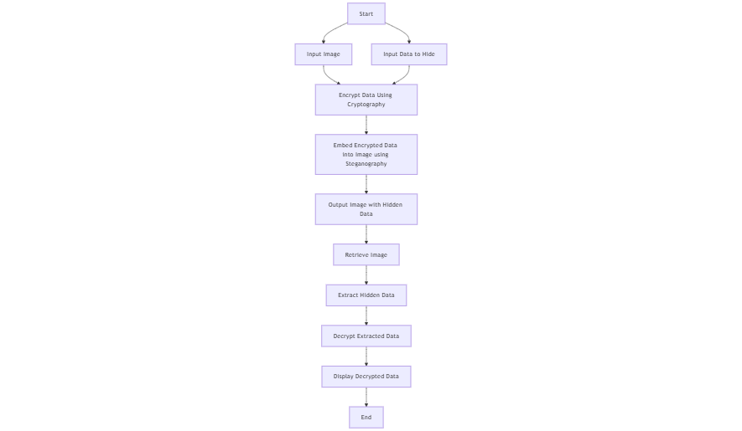
Work flow DFD

Slide 6
Wow factors
Combines encryption and steganography, offering a two-layer security mechanism.
Protects not only the data's confidentiality but also the integrity of the image, ensuring that modifications or tampering of the data are easily detectable.
Uses Python’s powerful libraries to implement both encryption and image manipulation seamlessly.
Hides sensitive data within images, making it nearly impossible to detect or alter without proper decryption.

Slide 7
End users
Security Enthusiasts: People interested in data privacy and security measures.
Businesses: Organizations seeking a secure way to transmit sensitive information without risking exposure.
Individuals: Users who want to communicate confidential data through digital images safely.
Software Developers: Developers looking for ready-made solutions to incorporate image-based data hiding in their own applications.

Slide 8
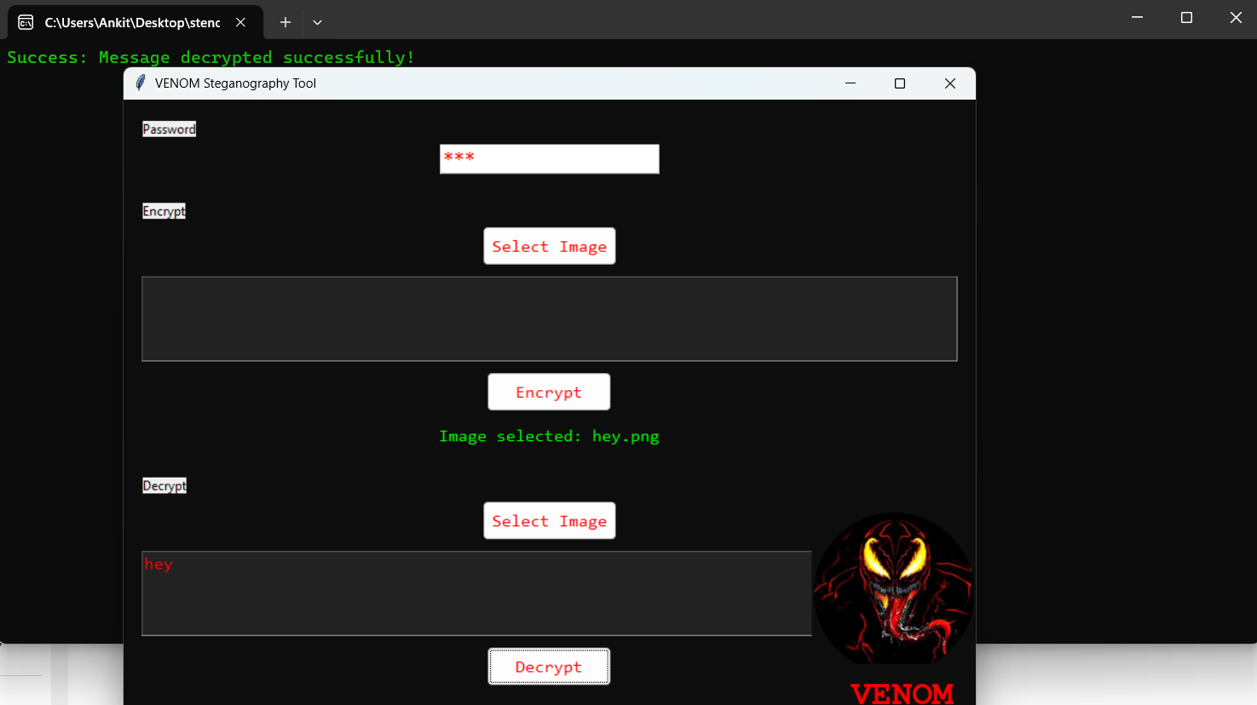
Screen shots

Slide 9
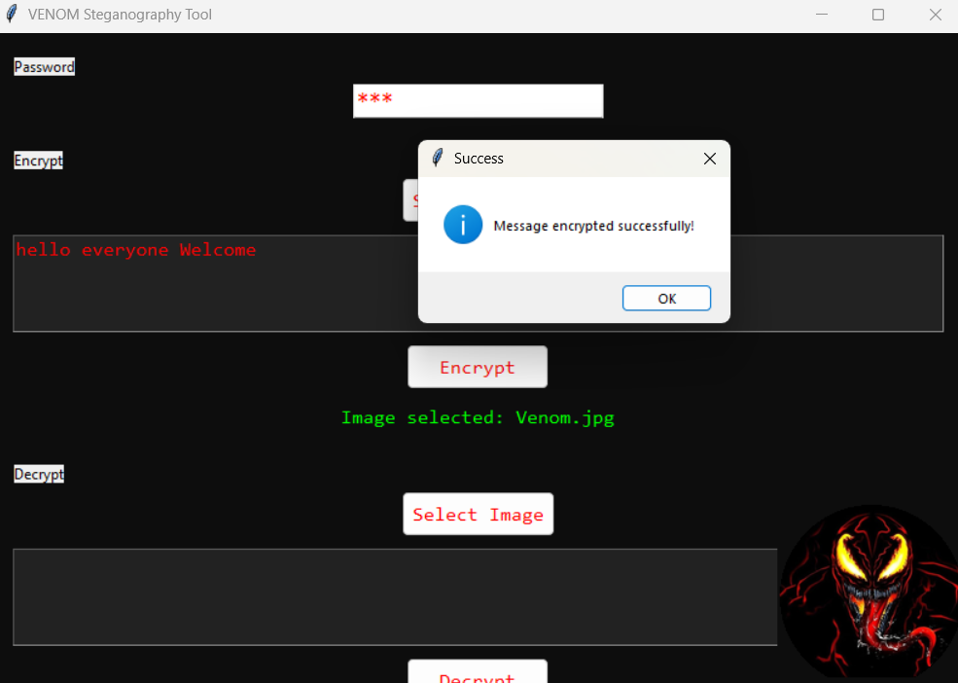
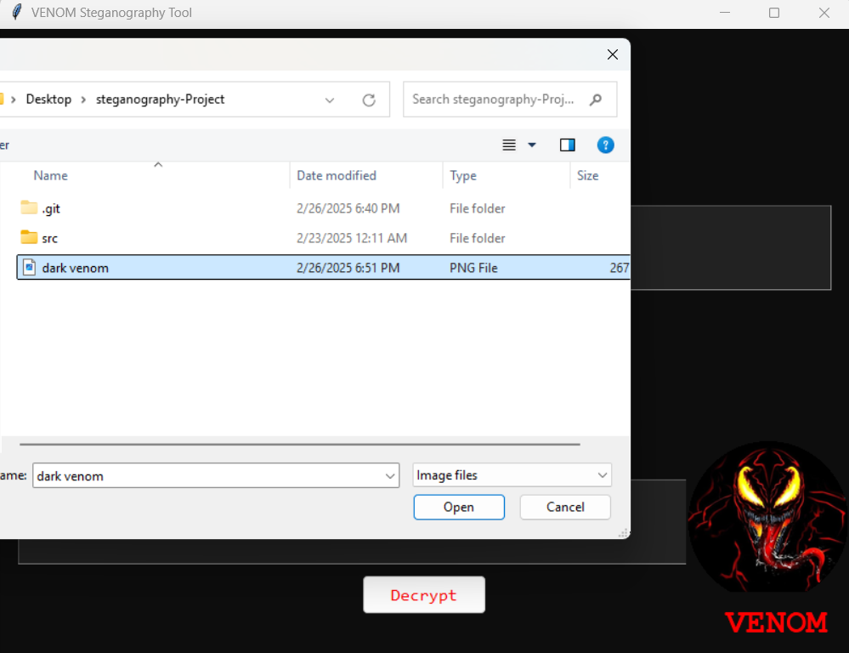
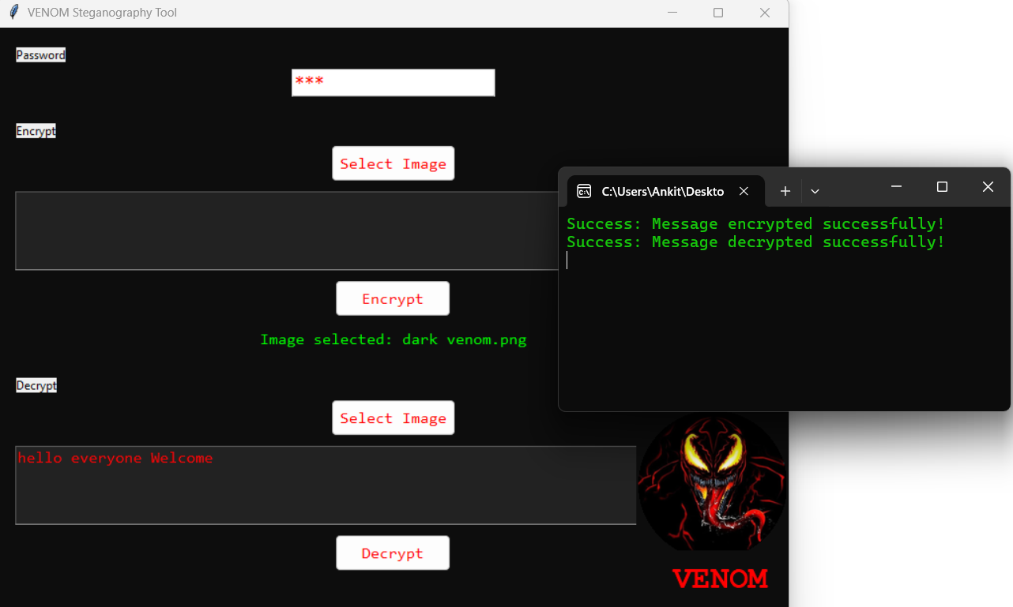
Results screenshot

Slide 10
Results
The project successfully hides and retrieves encrypted data within image files, ensuring that the original image's visual quality remains intact.
The cryptographic techniques ensure that even if someone accesses the image, the hidden data remains protected, only retrievable by authorized users.
A functional tool for secure communication using steganography and encryption methods.

Slide 11
Conclusion
The project demonstrates an effective implementation of data hiding through steganography, combined with encryption for an additional layer of security.
The result is a practical tool for secure communication and data storage, especially useful in contexts where privacy is paramount.
Future enhancements could include the use of other media types or more advanced encryption techniques.

Slide 12
GitHub Link
https://github.com/Ankitkumar341/stenography_project

Slide 13
Future scope(optional)
Integration with Other Media: Exploring the possibility of embedding data into other types of media, like audio or video files.
Enhanced Encryption: Implementing more sophisticated encryption algorithms to further secure the hidden data.
Mobile App: Developing a mobile application that allows users to hide and retrieve data securely from images.
Data Integrity Checks: Implementing hash functions or digital signatures to verify the integrity of the hidden data.
Steganalysis: Developing methods to detect steganography, useful for security professionals to detect and counteract such hidden data techniques.

Slide 14
THANK YOU

